Slide 1
BT 205: Cell & Molecular Biology
-Prof. Siddhartha Sankar Ghosh

Slide 2
Course Structure: 3-0-0-6
Time Table:
Monday: 3.00-4.00pm
Thursday: 2.00-3.00pm
Friday: 2.00-3.00pm

Slide 3
Syllabus after Mid Sem:
Transcription
Eukaryotic RNA splicing and processing
Translation, Regulation of gene expression
Cell signaling
Oncogenes, Programmed cell death
Genes in differentiation and development

Slide 4
Key Points:
Concept and basic understanding
Numerical and analytical problems
Application oriented
Materials to be supplied

Slide 5
Diverse living organisms share common chemical features

Slide 6
The universal features of living cells. All cells have a nucleus or nucleoid containing their DNA, a plasma membrane, and cytoplasm. Eukaryotic cells contain a variety of membrane-bounded organelles (including mitochondria, chloroplasts) and large particles (ribosomes).

Slide 7
A molecular or nanoscale device capable of converting energy into movement. Biological motor: Kinesin uses protein domain dynamics on nanoscales to walk along a microtubule.

Slide 8
A ribosome is a biological machine that utilizes protein dynamics on nanoscales

Slide 9
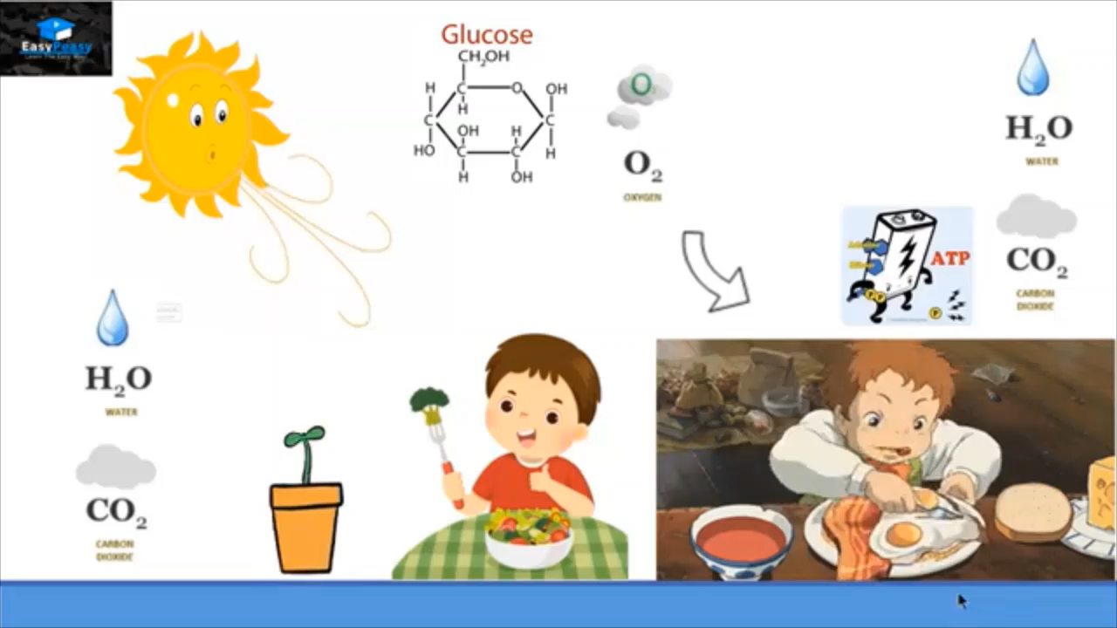

Slide 10
To be covered in Lec-1:
Thermodynamics in Bioenergetics
Biological Oxidation-Reduction Reactions

Slide 11
Bioenergetics is the quantitative study of energy relationships and energy conversions in biological systems.
Biological energy transformations obey the laws of thermodynamics

Slide 12
Biological Energy Transformations Obey the Laws of Thermodynamics:
The first law is the principle of the conservation of energy: for any physical or chemical change, the total amount of energy in the universe remains constant; energy may change form or it may be transported from one region to another, but it cannot be created or destroyed.
The second law of thermodynamics, which can be stated in several forms, says that the universe always tends toward increasing disorder: in all natural processes, the entropy of the universe increases.

Slide 13
System and Surroundings:
The reacting system and its surroundings together constitute the universe.
Closed: In the laboratory, some chemical or physical processes can be carried out in isolated or closed systems, in which no material or energy is exchanged with the surroundings.
Open: Living cells and organisms, however, are open systems, exchanging both material and energy with their surroundings; living systems are never at equilibrium with their surroundings, and the constant transactions between system and surroundings explain how organisms can create order within themselves while operating within the second law of thermodynamics.

Slide 14
Equation: Under the conditions existing in biological systems (including constant temperature and pressure), changes in free energy, enthalpy, and entropy are related to each other quantitatively by the equation:
Entropy:
The second law of thermodynamics states that the entropy of the universe increases during all chemical and physical processes, but it does not require that the entropy increase take place in the reacting system itself.
The order produced within cells as they grow and divide is more than compensated for by the disorder they create in their surroundings in the course of growth and division.
In short, living organisms preserve their internal order by taking from the surroundings free energy in the form of nutrients or sunlight, and returning to their surroundings an equal amount of energy as heat and entropy.

Slide 15
Cells Require Sources of Free Energy
Cells are isothermal systems—they function at essentially constant temperature (and also function at constant pressure).
Heat flow is not a source of energy for cells, because heat can do work only as it passes to a zone or object at a lower temperature.
The energy that cells can and must use is free energy, described by the Gibbs free-energy function G, which allows prediction of the direction of chemical reactions, their exact equilibrium position, and the amount of work they can (in theory) perform at constant temperature and pressure.
Heterotrophic cells acquire free energy from nutrient molecules, and photosynthetic cells acquire it from absorbed solar radiation.
Both kinds of cells transform this free energy into ATP and other energy-rich compounds capable of providing energy for biological work at constant temperature.

Slide 16
Gibbs free energy, G,
expresses the amount of energy capable of doing work during a reaction at constant temperature and pressure.
When a reaction proceeds with the release of free energy (that is, when the system changes so as to possess less free energy), the free-energy change, ΔG, has a negative value and the reaction is said to be exergonic.
In endergonic reactions, the system gains free energy and ΔG is positive.
Enthalpy, H,
is the heat content of the reacting system. It reflects the number and kinds
of chemical bonds in the reactants and products.
When a chemical reaction releases heat, it is said to be exothermic; the heat content of the products is less than that of the reactants, ΔH, has a negative value.
Reacting systems that take up heat from their surroundings are endothermic and have positive values of ΔH.

Slide 17
Entropy, S,
is a quantitative expression for the randomness or disorder in a system
When the products of a reaction are less complex and more disordered than the reactants, the reaction is said to proceed with a gain in entropy.

Slide 18
Standard Free-Energy and Equilibrium Constant:
The concentrations of reactants and products at equilibrium define the equilibrium constant, Keq In the general reaction
Key Convention: For convenience of calculations, biochemists define a standard state different from that used in chemistry and physics: in the biochemical standard state,
[H⁺] is 10⁻⁷ M (pH 7) and [H₂O] is 55.5 M.
For reactions that involve Mg²⁺ (which include most of those with ATP as a reactant), [Mg²⁺] in solution is commonly taken to be constant at 1 mM
Under standard conditions (298 K = 25 °C)

Slide 19
Standard Free-Energy and Equilibrium Constant:
Physical constants based on this biochemical standard state are called standard transformed constants and are written with a prime (such as ΔG′° and ) to distinguish them from the untransformed constants used by chemists and physicists.
In another simplifying convention used by biochemists, when H₂O, H⁺, and/or Mg²⁺ are reactants or products, their concentrations are not included in equations are incorporated into the constants a ΔG′° and

Slide 21
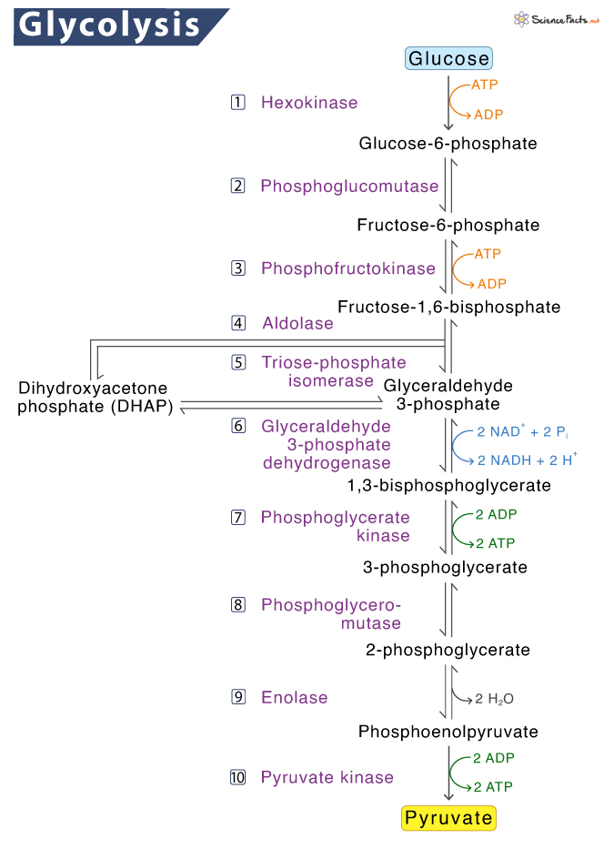

Slide 22
Q1. Calculate the standard free-energy change of the reaction catalyzed by the enzyme phosphoglucomutase.
given that, starting with 20 mM glucose 1-phosphate and no glucose 6- phosphate, the final equilibrium mixture at 25 °C and pH 7.0 contains 1.0 mM glucose 1-phosphate and 19 mM glucose 6-phosphate.
Does the reaction in the direction of glucose 6-phosphate formation proceed with a loss or a gain of free energy?

Slide 23
Solution: First we calculate the equilibrium constant:
We can now calculate the standard free-energy change:
Because the standard free-energy change is negative, the conversion of glucose 1-phosphate to glucose 6-phosphate proceeds with a loss (release) of free energy.

Slide 24
The term [C]^{c}[D]^{d}/[A]ª[B]^{b} is called the mass-action ratio Q. Thus Equation can be expressed as ΔG = ΔG′° + RT ln Q.

Slide 25
Standard Free-Energy Changes Are Additive

Slide 27
Summary
■Living cells constantly perform work. They require energy for maintaining their highly organized structures, synthesizing cellular components, transporting small molecules and ions across membranes, and generating electric currents.
■ Bioenergetics is the quantitative study of energy relationships and energy conversions in biological systems. Biological energy transformations obey the laws of thermodynamics.
■ All chemical reactions are influenced by two forces: the tendency to achieve the most stable bonding state (for which enthalpy, H, is a useful expression) and the tendency to achieve the highest degree of randomness, expressed as entropy, S. The net driving force in a reaction is ΔG, the free energy change, which represents the net effect of these two factors: ΔG = ΔH
− TΔS.
.

Slide 28
Summary:
■ The standard transformed free-energy change, ΔG′°, is a physical constant that is characteristic for a given reaction and can be calculated from the equilibrium constant for the reaction: ΔG′° = −RT ln .
■ The actual free-energy change, ΔG, is a variable that depends on ΔG′° and on the concentrations of reactants and products: ΔG = ΔG′° + RT ln ([products]/[reactants]).
■ When ΔG is large and negative, the reaction tends to go in the forward direction; when ΔG is large and positive, the reaction tends to go in the reverse direction; and when ΔG = 0, the system is at equilibrium.
■ The free-energy change for a reaction is independent of the pathway by which the reaction occurs. Free-energy changes are additive; the net chemical reaction that results from successive reactions sharing a common intermediate has an overall free-energy change that is the sum of the ΔG values for the individual reactions.

Slide 29
Biological Oxidation-Reduction Reactions

Slide 30
Oxidation-Reductions Can Be Described as Half- Reactions

Slide 31
Reduction Potentials Measure Affinity for Electrons:
When two conjugate redox pairs are together in solution, electron transfer from the electron donor of one pair to the electron acceptor of the other may proceed spontaneously.
The tendency for such a reaction depends on the relative affinity of the electron acceptor of each redox pair for electrons.
The standard reduction potential, E°, a measure (in volts) of this affinity, canbe determined experimentally.

Slide 32
Biological Oxidation-Reduction Reactions
Key Convention: Many half-reactions of interest to biochemists involve protons. As in the definition of ΔG′°, biochemists define the standard state for oxidation-reduction reactions as pH 7 and express a standard transformed reduction potential, E′°, the standard reduction potential at pH 7 and 25 °C.
By convention, ΔE′° for any redox reaction is given as E′° of the electron
acceptor minus E′° of the electron donor.
The energy made available by this spontaneous electron flow (the free-energy change, ΔG, for the oxidation-reduction reaction) is proportional to ΔE:

Slide 33
Biological Oxidation-Reduction Reactions
■ In many organisms, a central energy-conserving process is the stepwise
oxidation of glucose to CO₂, in which some of the energy of oxidation is
conserved in ATP as electrons are passed to O₂.
■ Biological oxidation-reduction reactions can be described in terms of two
half-reactions, each with a characteristic standard reduction potential, E′°.
■ When two electrochemical half-cells, each containing the components of a
half-reaction, are connected, electrons tend to flow to the half-cell with the
higher reduction potential. The strength of this tendency is proportional to the
difference between the two reduction potentials (ΔE) and is a function of the
concentrations of oxidized and reduced species.
■ The standard free-energy change for an oxidation-reduction reaction is
directly proportional to the difference in standard reduction potentials of the
two half-cells: ΔG′° = −nFΔE′°.

Slide 34
Redox reactions: The flow of electrons in oxidation-reduction reactions is responsible, directly or indirectly, for all work done by living organisms.
The two chemical species differ in their affinity for electrons, electrons flow spontaneously through the circuit, driven by a force proportional to the difference in electron affinity, the electromotive force, emf.
In biological systems, oxidation is often synonymous with dehydrogenation, and many enzymes that catalyze oxidation reactions are dehydrogenases.
The tendency for such a reaction depends on the relative affinity of the electron acceptor of each redox pair for electrons. The standard reduction potential, E°, a measure (in volts) of this affinity.

Slide 35
■ Many biological oxidation reactions are dehydrogenations in which one or
two hydrogen atoms (H⁺ + e⁻) are transferred from a substrate to a hydrogen
acceptor. Oxidation-reduction reactions in living cells involve specialized
electron carriers.
■ NAD and NADP are the freely diffusible coenzymes of many dehydrogenases. Both NAD⁺ and NADP⁺ accept two electrons and one proton. In addition to its role in oxidation-reduction reactions, NAD⁺ is the source of AMP in the bacterial DNA ligase reaction and of ADP-ribose in the cholera toxin reaction, and is hydrolyzed in the deacetylation of proteins by some sirtuins.
■ FAD and FMN, the flavin nucleotides, serve as tightly bound prosthetic groups of flavoproteins. They can accept either one or two electrons and one or two protons. Flavoproteins also serve as light receptors in cryptochromes and photolyases.

Slide 36


Slide 37
NAD and NADP. (a) Nicotinamide adenine dinucleotide, NAD⁺, and its phosphorylated analog, NADP⁺, undergo reduction to NADH and NADPH, accepting a hydride ion (two electrons and one proton) from an oxidizable substrate. The hydride ion is added to either the front or the back of the planar nicotinamide ring. (b) The UV absorption spectra of NAD⁺ and NADH. Reduction of the nicotinamide ring produces a new, broad absorption band with a maximum at 340 nm. The production of NADH during an enzyme catalyzed reaction can be conveniently followed by observing the appearance of the absorbance at 340 nm (molar extinction coefficient ε340 = 6,200 M⁻¹ cm ⁻¹).

Slide 38
Flavin Nucleotides Are Tightly Bound in Flavoproteins. Flavoproteins are enzymes that catalyze oxidation-reduction reactions using either flavin mononucleotide (FMN) or flavin adenine dinucleotide (FAD) as coenzyme. These coenzymes, the flavin nucleotides, are derived from the vitamin riboflavin.
The fused ring structure of flavin nucleotides (the isoalloxazine ring) undergoes reversible reduction, accepting either one or two electrons in the form of one or two hydrogen atoms (each atom an electron plus a proton) from a reduced substrate.
The fully reduced forms are abbreviated FADH2 and FMNH2. When a fully oxidized flavin nucleotide accepts only one electron (one hydrogen atom), the semiquinone form of the isoalloxazine ring is produced, abbreviated FADH• and FMNH•. Because flavin nucleotides have a slightly different chemical specialty from that of the nicotinamide coenzymes—the ability to participate in either one- or two electron transfers—flavoproteins are involved in a greater diversity of reactions than the NAD(P)-linked dehydrogenases.

Slide 40
Walther Nernst derived an equation that relates standard reduction potential (E°) to the actual reduction potential (E) at any concentration of oxidized and reduced species in a living cell.
where R and T have their usual meanings, n is the number of electrons transferred per molecule, and F is the Faraday constant, a proportionality constant that converts volts to joules. At 298 K (25 °C), this expression reduces to

Slide 41
Calculate the standard free-energy change, ΔG′°, for the reaction in which acetaldehyde is reduced by the biological electron carrier NADH:

Slide 43
The complete oxidation of glucose
has a ΔG′° of −2,840 kJ/mol. This is a much larger release of free energy than is required for ATP synthesis in cells (50 to 60 kJ/mol)

Slide 45
THANK YOU

